Slide 1

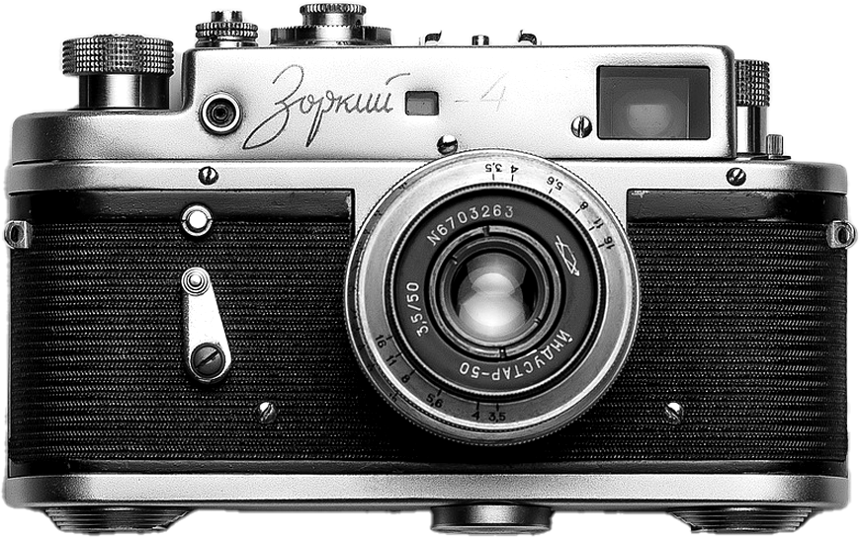


Peter Skaar
Henrik Vallestad
Jonny Hugøy
Ole August Solheim
FireGuard
----------- Gruppe 1

Slide 2
Peter Skaar
Henrik Vallestad
Jonny Hugøy
Ole August Solem
FireGuard
----------- Gruppe 1

Slide 3



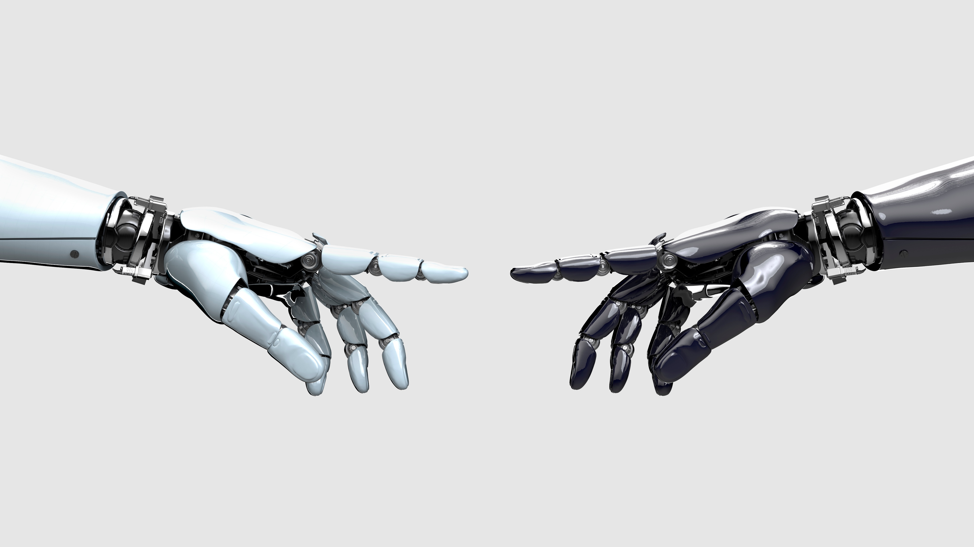

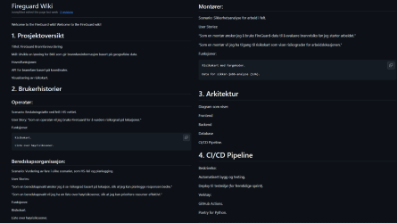
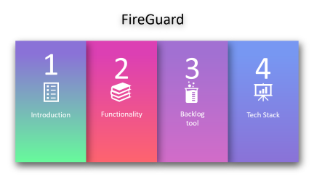

Slide 4




FireGuard
1
2
3
4
Introduction
Functionality
Backlog tool
Tech Stack

Slide 5
FireGuard
Backlog tool
Introduction
Tech Stack
Develop solution for BKK to detect fire risk based on geographical data
Functionality

Slide 6
FireGuard
Functionality
Backlog tool
Introduction
Tech Stack
API based on coordinates Visualization as a risk-map

Slide 7
FireGuard
Introduction
Backlog tool
Tech Stack
Functionality
GitHub https://github.com/JonnyMast/FireGuard

Slide 8
FireGuard
Backlog tool
Introduction
Tech Stack
Functionality
Python
FastAPI
Database (Azure) Postman
Docker GitHub Actions

Slide 9
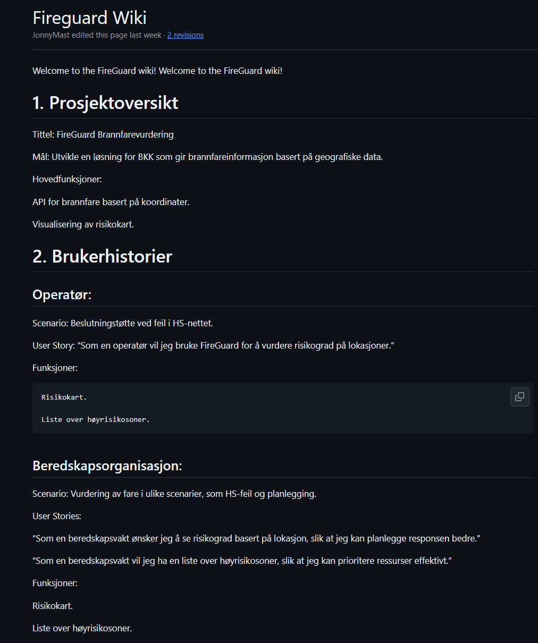
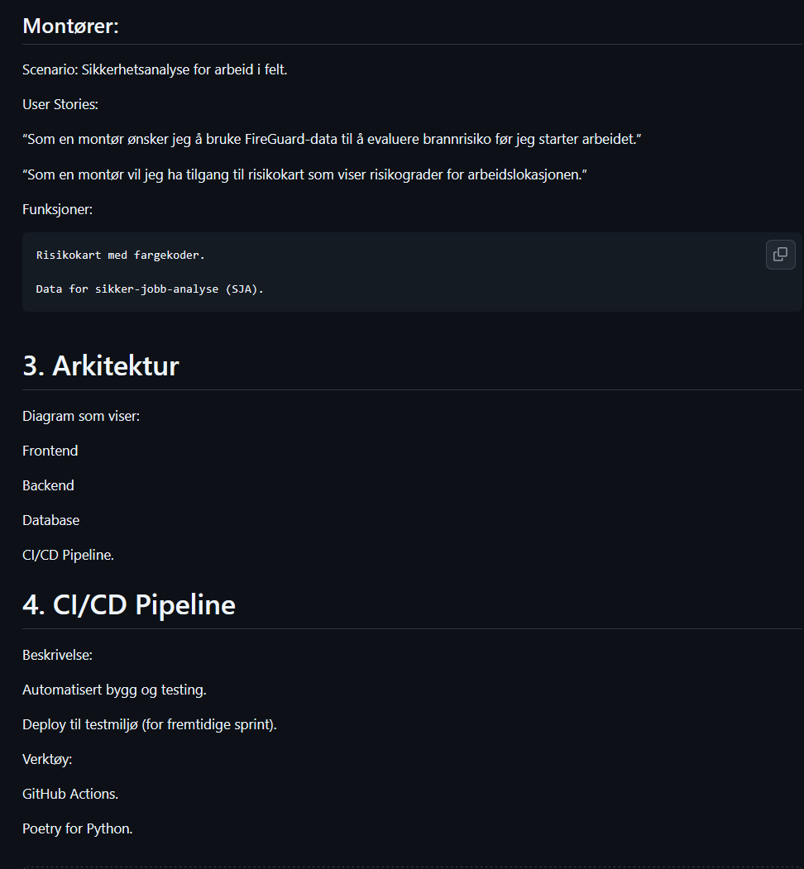

Slide 10

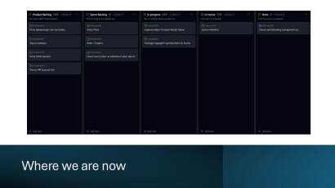

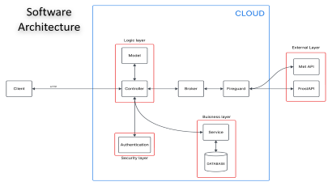


Slide 11
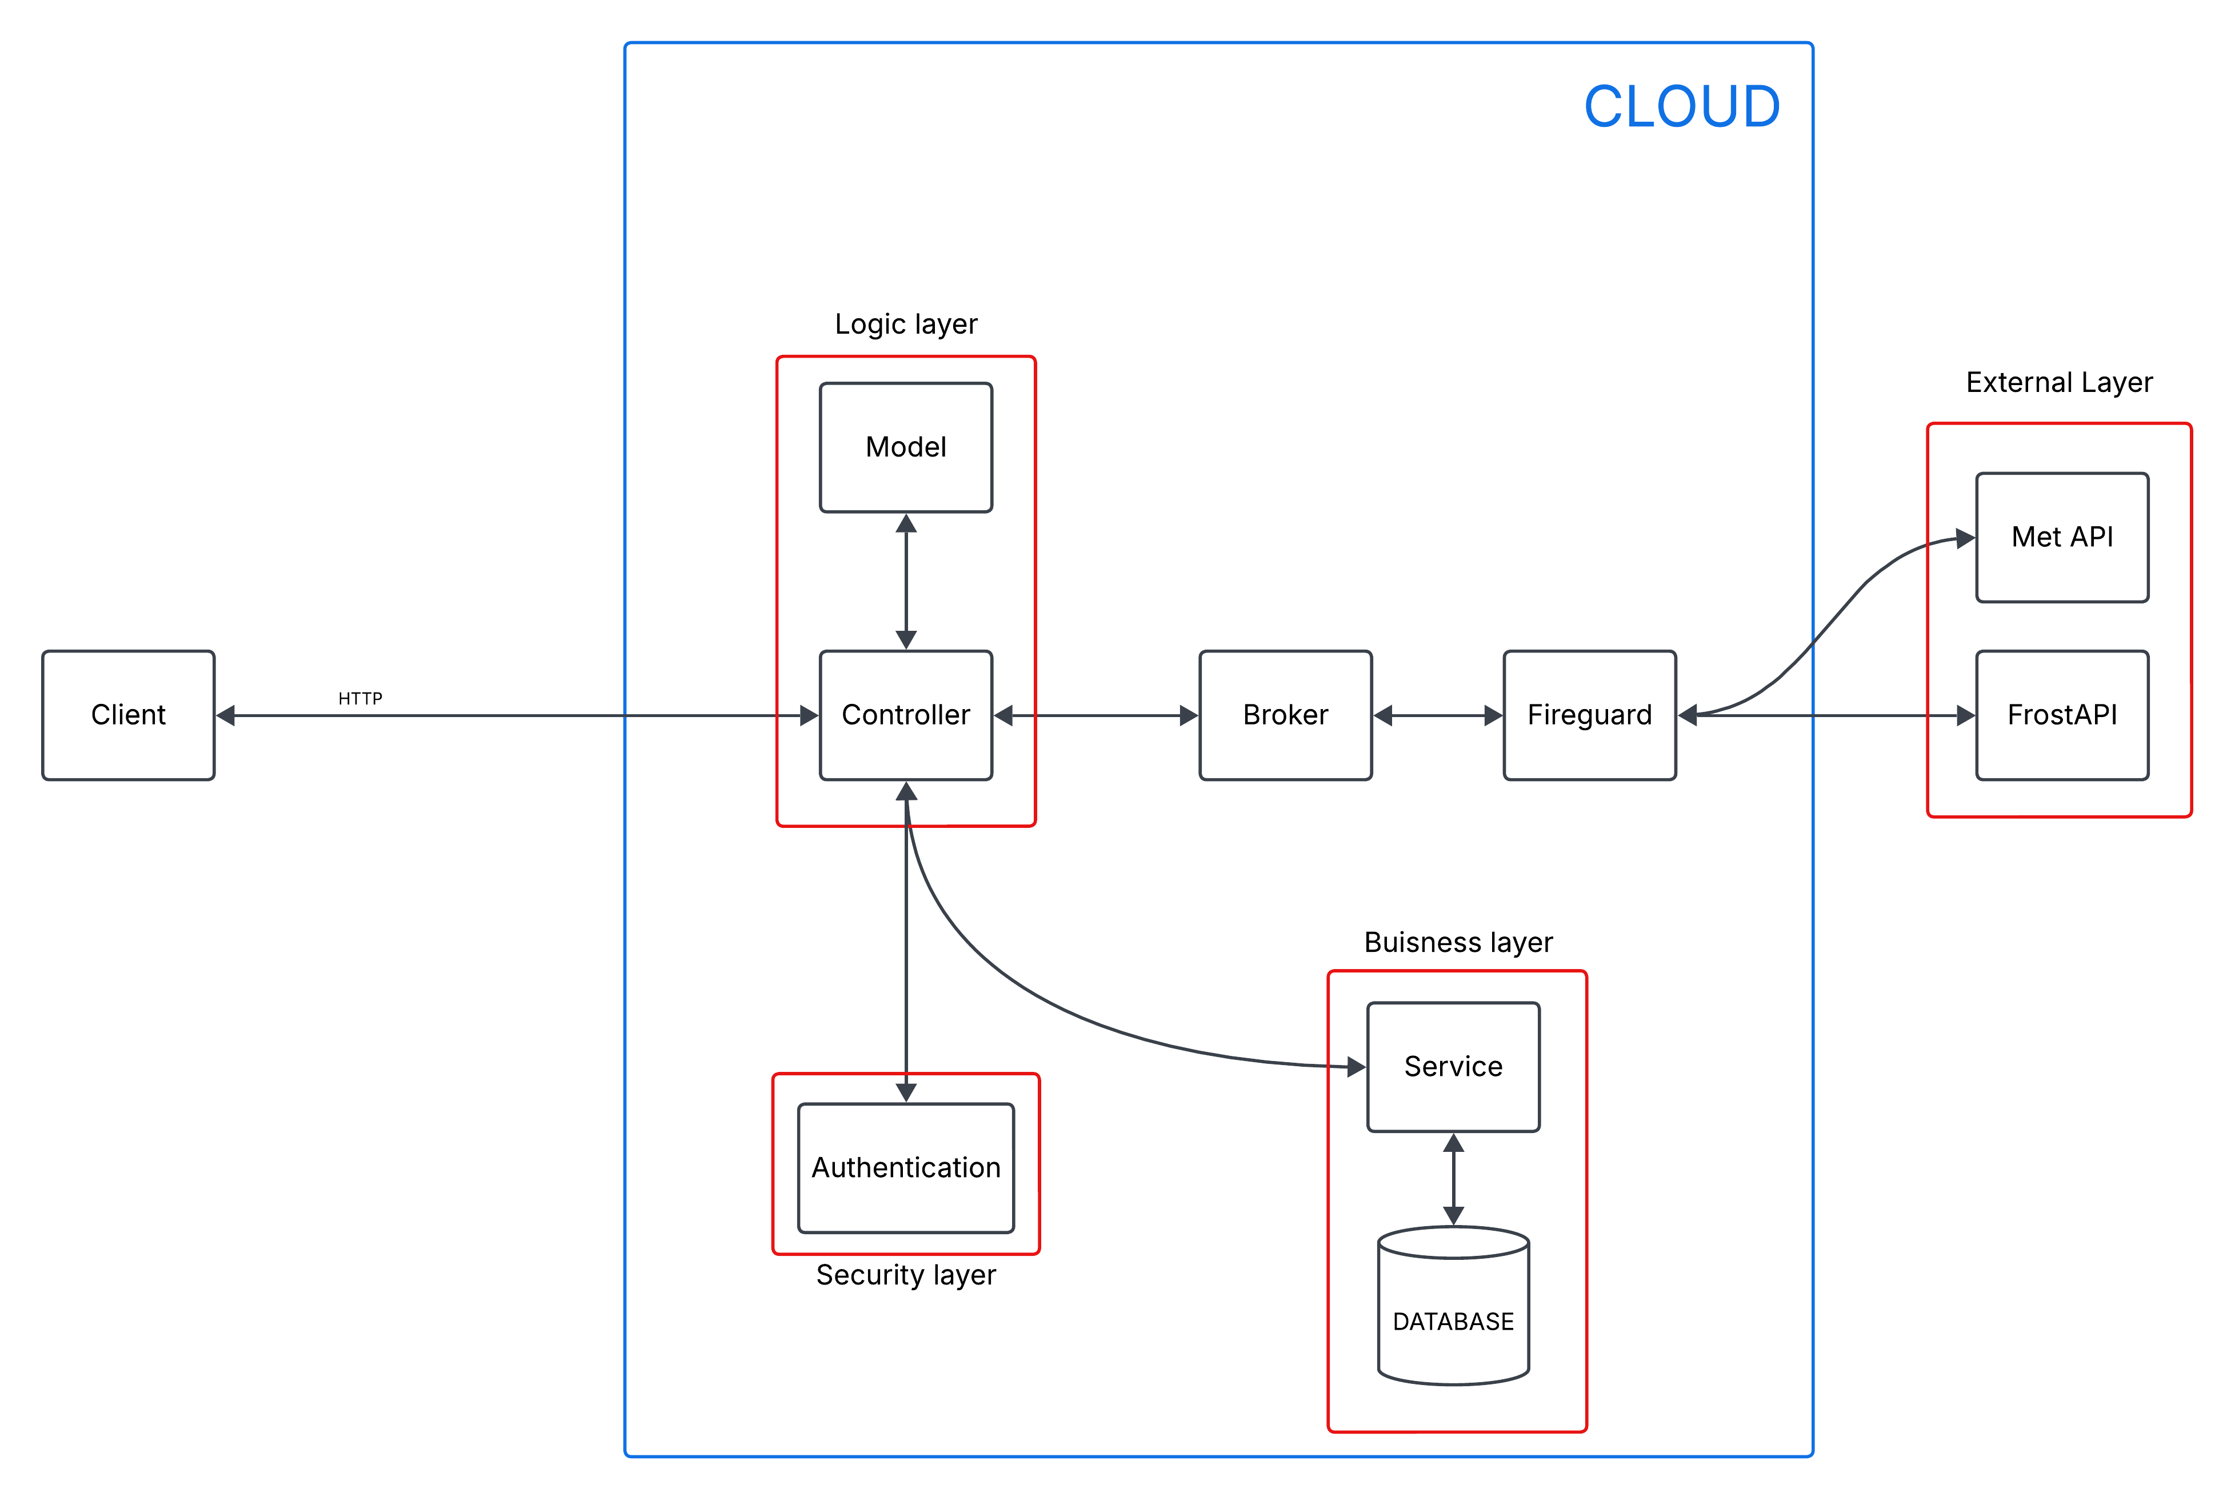
Software Architecture
Your Third Slide Here

Slide 12
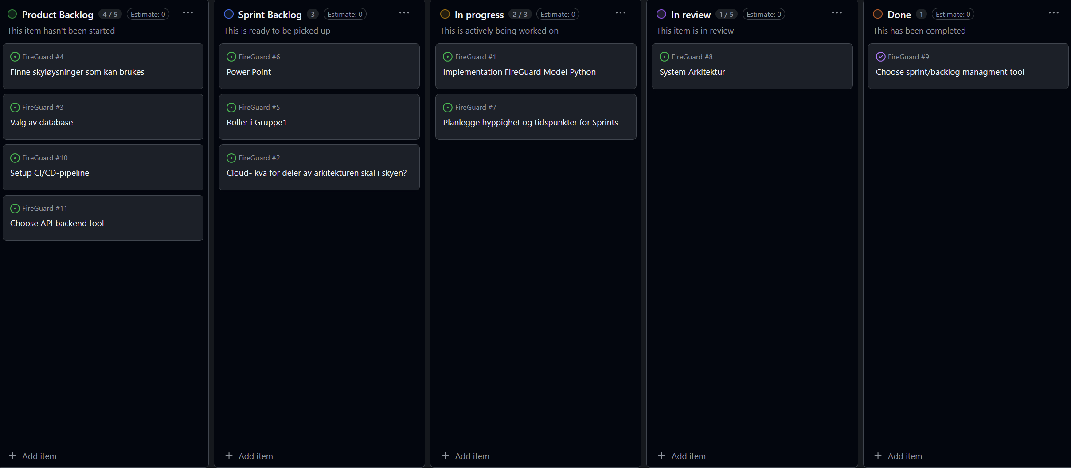
Where we are now

Slide 13
THANK
YOU

